Slide 1
Capital Gains & Losses
(Including Sale of Home)
Pub 17 Chapters 13-16
Pub 4012 Tab D
(Federal 1040-Line 13)
(NJ 1040-Line 18)
Notes:
1

Slide 2
Introduction
What is a capital gain (loss)?
  It’s your profit (loss) when you sell a capital asset for more (less) than you have in it
Capital assets
  Generally, nonbusiness assets such as securities, e.g. stocks, bonds, mutual funds
NOT a capital asset
  Inventory
  Property used as a rental or in a business
  Copyright, a literary, musical, or artistic composition letter, memo or similar
“Sort-of” capital assets
  Homes and other personal use items (e.g. boat, jewelry, car, etc.)
    Capital assets for gains (taxed)
    Personal assets for losses (not deductible)

Slide 3

Stock Sales – Schedule D
Key elements of stock sale
  When was it bought?
  When was it sold?
  What was the sales price?
  What was the cost basis?
Use TW Capital Gain/Loss Worksheet for entering data for each transaction
Notes:
3

Slide 4
Stock Sales – Capital Gains
TW does the following:
  Determines whether long/short term
  Calculates taxable gain/loss
  Calculates tax liability on worksheet
  Calculates capital loss carryover to next year
Notes:
Long-term capital gains rates for 2014
0% - if in 10% or 15% tax bracket
15% - if in 25%-35% tax bracket
20% - if in 39.6% tax bracket
4

Slide 5
Sales Price
Obtained from end-of-year tax statement:
  1099 B - Proceeds From Broker & Barter Exchange Transactions
  1099 Consolidated Statement
May be reported as gross proceeds or net proceeds (less commissions)
Notes:
5

Slide 6
Cost Basis
Cost basis is cost plus commission on purchase
Assume First In First Out (FIFO) unless specified in writing, before sale
Original basis is adjusted by any stock split or non-taxable dividend (return of principal)
Cost basis of taxable stock dividends & Dividends Reinvestments (DRIP) is the price of the stock on distribution date
Notes:
6

Slide 7
Cost Basis
(cont’d)
Adjusted cost basis & short/long-term status for “covered securities” must be reported on 1099-B
Securities are “covered” if they were acquired after:
  1/1/2011 Stocks (including REITs, ADRs, & some ETFs)
  1/1/2012 Mutual funds, stock DRIPS, rest of ETFs
  1/1/2013 Notes, bonds, options, commodities
If securities were purchased prior to required coverage date, taxpayer must provide cost basis
Tax law allows use of average of stock price during approximate period of purchase, if no other records are available (must be provided by taxpayer)
Notes:
“Covered” securities were developed to standardize the regulations and filings of securities in the United States
Financial institutions must provide cost basis for “Covered” Securities
7

Slide 8


Basis other than Cost
Inherited in 2010 - tax law changed for that one year
  Out of Scope (unless provided by executor)
Gifts received
  Out of Scope
Average of stock price
  In scope only if client provides average price
  Out of Scope if counselor must calculate
Taxpayer cannot provide information
  In scope only if client agrees to take a zero cost basis
Employee stock options (ESOP)
  Out of Scope
Notes:
Inherited capital gains are always considered long-term gains
Law was changed for assets inherited in 2010 and then changed back in 2011. That is why assets inherited in 2010 are Out of Scope unless the cost is specifically supplied by executor of estate
8

Slide 9
Adjusted Basis
Events can change the per share basis
  Stock splits
    Buy 100 shares @ $10 per share, splits 2 for 1
    Now have 200 shares @ $5 per share
  Dividend reinvestments
    Buy additional shares at current price
    Example:
      100 shares @ $10
      5 shares @ $20
      3 shares @ $18
Notes:
9

Slide 10
Sales Commissions
Commission paid will affect the gain/loss
  If 1099-B reports sale as net
    No adjustment to gain/loss is needed
  If 1099-B reports sale as gross
    Adjustment to reduce gain/loss is needed to reflect commission paid
    Use adjustment code E
    Do not add sales commission to cost basis as we did in prior years
Notes:
10

Slide 11
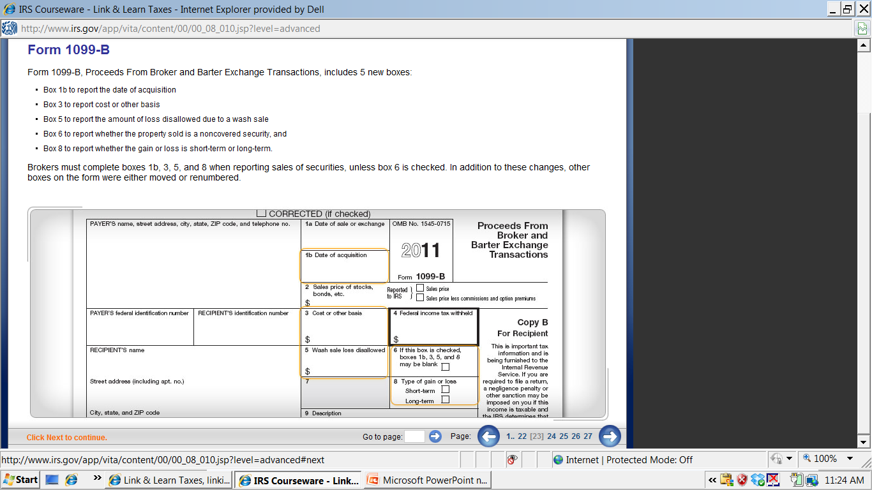
1099-B Proceeds from Broker and Barter Exchange Transactions
Date sold
2014
Date acquired
Cost
Box checked for non-covered
S/T or L/T
Notes:
If Box 6 is checked, the security is “non-covered.” Thus, Boxes 1b, 3, 5, & 8 may be blank
11

Slide 12
1099-B Fields
Box 1a: Date of Sale
Box 1b: Date of Acquisition
Box 3: Cost or Other Basis
Box 5: Loss Disallowed due to Wash Sale
Box 6: Non-covered security or
Covered security (Basis Reported to IRS)
    Box will be checked for non-covered security
Box 8: Short- or Long-Term Status
NOTE: Broker must complete Boxes 1b, 3, 5, & 8 if
Box 6 is not checked to show security is non-covered
Notes:
12

Slide 13
Holding Period-
Short Term (ST) vs. Long Term (LT)
Stock held one year or less is short term
  Begin counting the day after the trade date
  Taxed at regular tax rates
Stock held more than year is long term
  Taxed at capital gains rates
Notes:
13

Slide 14
Holding Period -
May Need to Determine LT vs. ST
Stock Dividends & DRIP
Shares acquired in tax-free stock dividend or stock split have same holding period as original shares
Holding period for taxable stock dividends & Dividend Reinvestments (DRIP) are based on the date of declaration
  They do not revert to the holding period of the original stock
Notes:
14

Slide 15
Holding Period - May Need to Determine Long Term vs. Short Term
(cont’d)
If sale of all shares bought on various dates, at different prices (multiple blocks), enter “VARIOUS” in Date Acquired column
  TW assumes long term
  If short-term, enter actual purchase dates OR override S/L column to make it S
    Override – F8
Notes:
15

Slide 16
Tax Liability Net Gain
If there is both net long-term & net short-term gain:
  Net long-term gain will be taxed at the lower capital gain rate
  Net short-term gain will be taxed at the higher ordinary income tax rate
If net long-term gain exceeds net short-term loss, the net gain is taxed at capital gain rates (TW calculates)
Notes:
16

Slide 17
Capital Gains Tax Rates
(0% new in 2008, extended thru 2014)
Short term capital gains taxed at ordinary income tax rate for tax bracket
Beginning 2008 through end of 2014, Long Term Capital Gains rates decreased to 0% for taxpayers in 10% & 15% tax brackets
Capital gains rate of 15% if in 25 – 35% brackets
Maximum capital gains rate is 20%
Notes:
17

Slide 18
Tax Liability Net Loss
Net loss can offset all gains, plus
  Up to $3,000 can be used to reduce other taxable income in the current tax year ($1,500 if MFS)
The loss amount in excess of $3,000 (or $1,500 if MFS) is carried forward to the next tax year
Notes:
18

Slide 19
Capital Loss Carryover
Check prior year Schedule D or related worksheet to determine carryover loss
Carryover losses keep their short-term or long-term classification
Carryover losses are combined with the gains and losses that actually occur in the subsequent year
No limit to how many times a loss can be carried forward
Notes:
19

Slide 20
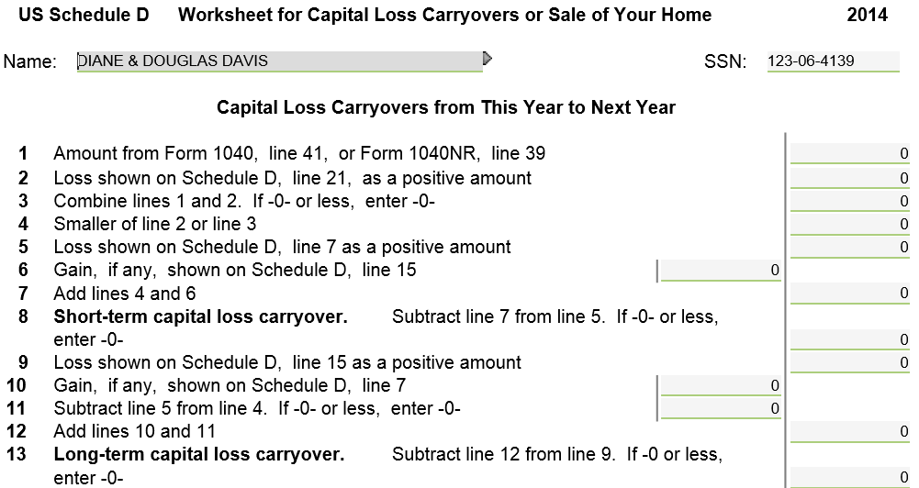
Capital Loss Carryover From This Year to Next Year - Schedule D Worksheet 2
Short Term carryover from This Year to Next Year
Long Term carryover from This Year to Next Year
Required For Next Year’s Returns
Notes:
When there is a capital loss to carry over from this year to next year, TW will populate Lines 8 & 13 of the Schedule D Worksheet 2 in current year; needed for preparing following year’s return
20

Slide 21
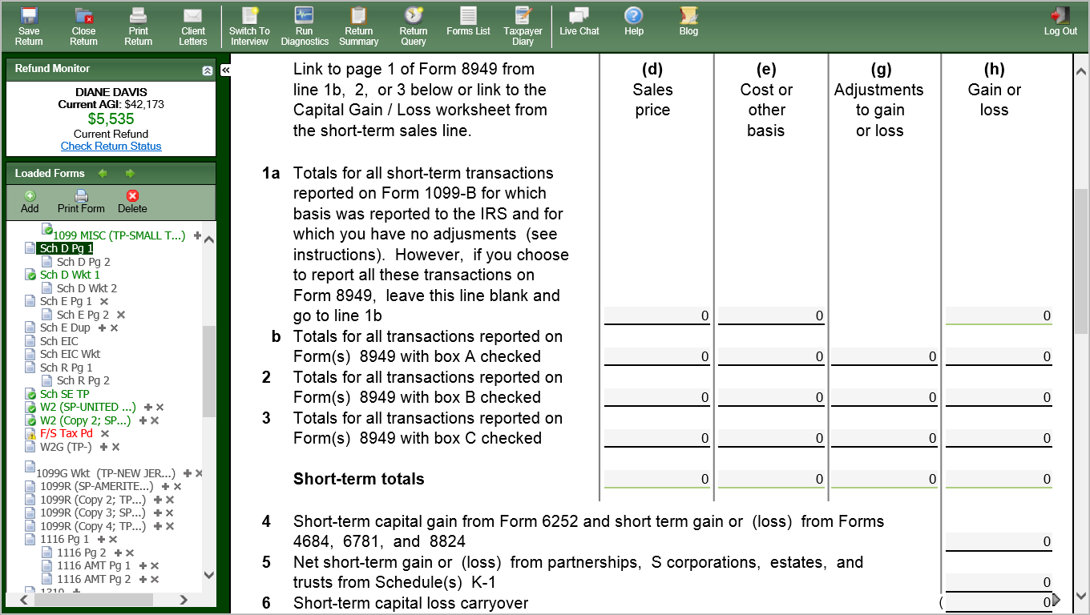
Capital Loss Carryover From Last Year to This Year - Schedule D Page 1
Enter short-term carryover loss from last tax year to this year on Line 6 (if return has carry-forward data, it will populate automatically)
Enter long-term carryover from last tax year to this year on Line 14
Notes:
If TW has carry-forward data for a client from last year, the capital loss carryover will automatically populate on Schedule D Line 6 for short term and/or Line 14 for long term. If TW does not have carry-forward data for the client, the amounts on Lines 8 and 13 from the prior year’s Schedule D Worksheet 2 have to manually entered into Line 6 (short term) or Line 14 (long term) on Sch D

Slide 22
Capital Gain Distributions
These distributions result when mutual funds that sold stock pass resulting gains to taxpayer each year
  Result from sales within the mutual fund; does not matter if taxpayer sold the fund itself or still owns it
Treated as long-term capital gain. Enter on 1099-DIV worksheet
  If Sch D required for other transactions, will flow to Sch D, then to 1040 line 13
  If these are the only capital gains, no Schedule D required and will flow directly to 1040 line 13
Reported on 1099-DIV Box 2a or Broker’s Consolidated Statement
Notes:
Explain that you may received capital gain distributions form a mutual fund even if you do not sell anything. These distributions are based on gains that the mutual fund receives on sales within the fund. Mutual funds are required by law to pass those gains on to the shareholders
22

Slide 23
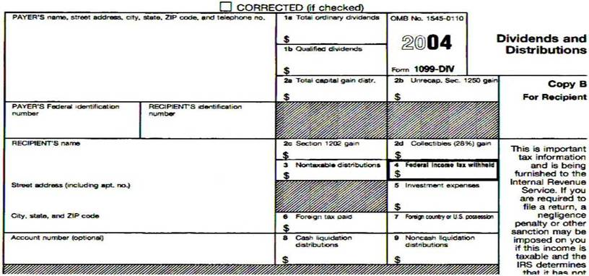
1099-DIV
Dividends & Distributions
2014
Notes:
Sample 1099-DIV showing where the Capital Gains Distribution would be reported
23

Slide 24
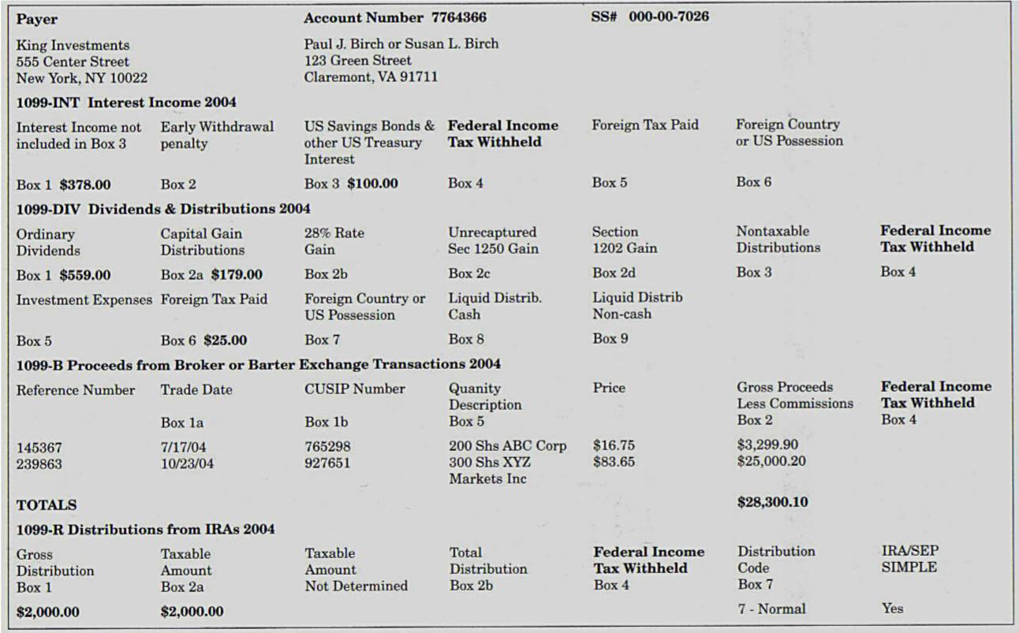
1099 Consolidated Statement
Notes:
1099 Consolidated Statement showing where the Capital Gains Distribution would be reported
24

Slide 25
Demutualization
Demutualization occurs when insurance company is changed from a “mutual company” to a “stock company” & issues stock or cash to policyholders in the new company
  Per IRS, cost basis of stock issued is $0
  When sold, stock is always long term
  Several court cases have issued different rulings on cost basis. Taxability varies depending on the type of transaction. If amount is significant and affects the tax owed, the taxpayer may benefit by going to a paid preparer
Notes:
Demutualization:
The process through which a member-owned company becomes shareholder-owned
Frequently this is a step toward the initial public offering (IPO) of a company
25

Slide 26
Schedule K-1
Capital Gains & Losses
End-of-year tax statement:
  Schedule K-1 (8865) Partner’s Share of Income shows
  Net short-term capital gain (loss)
  Net long-term capital gain (loss)
Where to report?
  Do NOT fill out K-1 Worksheet. Instead:
    S/T - Report on Sch D Line 5 using scratch pad
    L/T – Report on Sch D Line 12 using scratch pad
  Use “Sch K-1” as payer
See TaxPrep4Free.org Special Topic document
  “K-1 Income Entry”
Notes:
Schedule K-1 reports each shareholder's pro-rated share of net income or loss
Only in scope transactions/financials from K-1 are:
Interest
Dividends
Capital Gains
Royalties
26

Slide 27
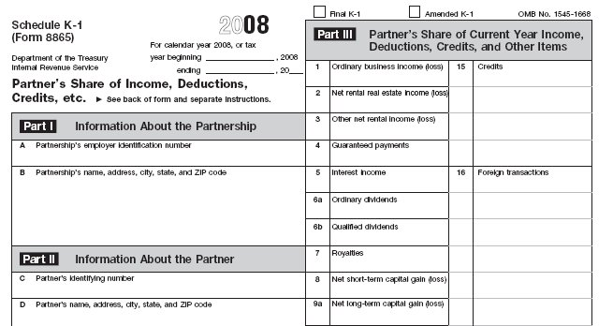
Sample Schedule K-1
2014
  Note: K-1s may vary in format
Notes:
Sample K-1 showing where short-term & long-term capital gains would be reported
27

Slide 28
Wash Sales
Definition of a wash sale:
  A stock sold by taxpayer at a loss & substantially equivalent stock is purchased within 30 days (either before or after). The loss is not deductible
1099-B, brokerage statement will show:
  Original sales price in Box 2 & cost in Box 3
  Wash Sales Disallowed in Box 5
On Capital Gains/Loss Wkt, enter sales price & cost. Enter adjustment code W in Column f & wash sale amount as positive in Column g. Will zero out loss
Add disallowed loss to cost basis of new stock bought
Notes:
28

Slide 29
Sample-Capital Gain/Loss Problem
Douglas owned 100 shares of Premier mutual fund he purchased on 8/15/1983 for $20,000
The records show he reinvested capital gains totaling $8,000, interest totaling $7,000 & dividends totaling $3,000. All reinvestments qualify for Long Term Capital Gain
He sold this fund for $39,201 on 11/15/2014
What is his capital gain from Premier Mutual stock?
$1,201
Notes:
29

Slide 30
TW Entering Capital Gain/Loss Transactions
Enter all gain/loss info on Capital Gain/Loss Transaction Worksheet, not on Schedule D or Form 8949
  Worksheet is near top of list in Forms Tree
TW will transfer info from Worksheet to appropriate Form 8949, Schedule D, & 1040
Notes:
30

Slide 31
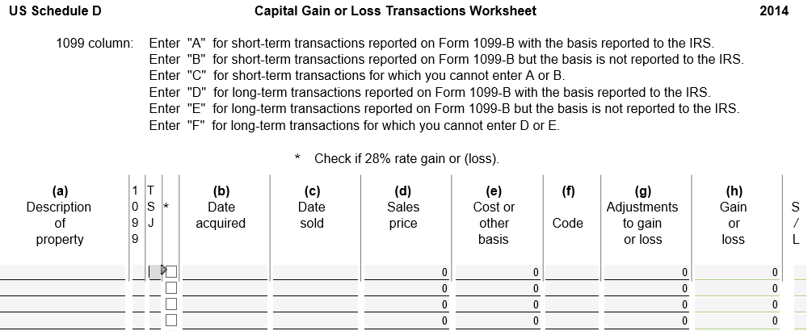
Columns on Capital Gain/Loss Transactions Worksheet
Notes:
31

Slide 32
Columns on Capital Gain/Loss Transactions Worksheet
1099 column codes
  A – Short-term with cost basis reported to IRS
  B – Short-term with cost basis not reported to IRS
  C – Short-term with no 1099-B
  D – Long-term with cost basis reported to IRS
  E – Long-term with cost basis not reported to IRS
  F – Long-term with no 1099-B
* Column – use if maximum tax rate is 28%
  E.g. – collectibles gain (We don’t use this field)
Notes:
If brokerage statement shows cost on Year-End Summary pages, but not on actual 1099-B, use code B - Cost basis not shown on 1099-B
32

Slide 33
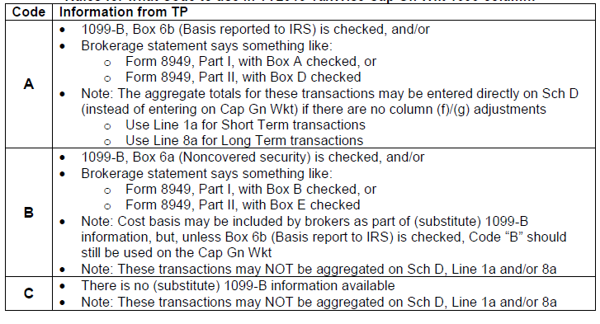
Rules for What Code to use in TW Capital Gains Worksheet 1099 Column
From TaxPrep4Free.org Special Topics Document “Using Sch D Lines 1a/8a”

Slide 34
Other Special Columns on Capital Gain/ Loss Transactions Worksheet
(cont’d)
Column f – Gain/Loss adjustment codes
  See Pub 4012 Tab D for codes to explain reason for adjustment
  Most common:
    Code H to exclude gain from Sale of Main Home
    Code E if 1099-B shows Gross Sales Price
Column g – Adjustments to gain/loss
  Amount of adjustment
  Pub 4012 Tab D specifies whether to enter amount as positive or negative number
Notes:
34

Slide 35
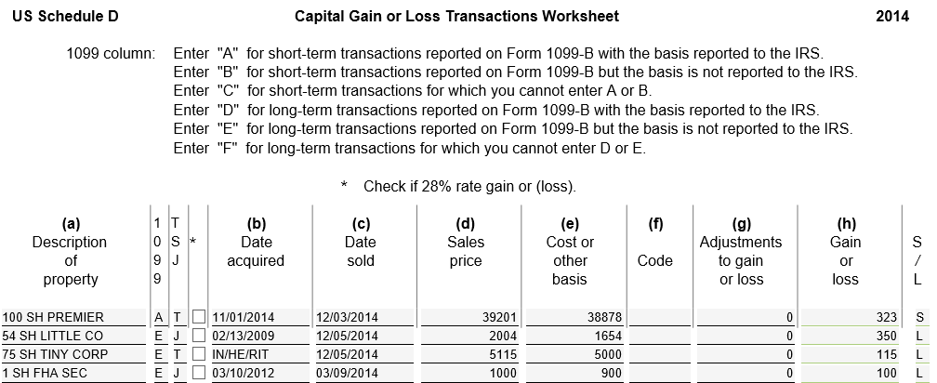
TW Capital Gain/Loss Transactions Worksheet
Notes:
Use Capital Gains/Loss Transactions Worksheet from Forms Tree
Enter Description of security sold in Column a
Include # of shares if stock
Enter appropriate 1099 Code
Enter T if 1099-B belongs to taxpayer, S for spouse, J for joint
* column is used if maximum tax rate is 28%, such as a gain on collectibles (we don’t use)
Enter Date Acquired (from 1099-Box 1b or taxpayer) in Column b
& Date Sold (from 1099-B Box 1a) in Column c
TW will use these dates to determine short or long term & will populate S/L column. TW will then transfer short-term and long-term gains/losses to the appropriate 8949 form
Use VARIOUS as Date Acquired if shares of same asset were purchased on multiple dates. TW assumes VARIOUS are long-term transactions, so S/L column must be overridden with an S for multiple short-term transactions
Use INHERIT as Date Acquired for asset inherited from someone who died prior to 1/1/2010 & after 12/31/2010. TW will assume long term
Special rules apply to assets inherited from someone who died in 2010 (Out of Scope unless cost is provided by executor because tax law changed for that one tax year)
Enter Sales Price (from 1099-B Box 2) in Column d
Enter Cost or Basis (from 1099-B Box 3 or taxpayer) in Column e
If Sales Price on 1099-B was a gross figure (sales commission was not subtracted), enter Adjustment Code E in Column f & negative amount of commission in Column g to reduce gain/loss
If taxpayer does not have records with cost, suggest contacting broker or looking up price of asset on date bought on the internet. If no cost is listed, entire sales price will be taxable
Enter Gain/Loss Adjustment Code (if needed) – Pub 4012 Tab D for codes
Enter Gain/Loss Adjustment Amount (if needed) – Pub 4012 Tab D to determine if amount should be entered as a positive or negative number
LINK TO Forms 8949 in FORMS TREE
TW will transfer all related transactions (1099 Codes A, B, C, D, E, F) to the appropriate Form 8949
LINK TO Schedule D in FORMS TREE
TW will transfer summary info from each 8949 to the appropriate line on Schedule D Parts I or II
LINK TO 1040 PAGE 1 IN FORMS TREE
TW will then populate 1040 Line 13 with capital gain/loss
Loss on Line 13 is capped at $3,000. If loss is greater than that, TW will prepare Sch D Worksheet 2 for Capital Loss Carryovers for future years
35

Slide 36
Capital Gains/Loss Transaction Worksheet – TW Tips
Enter:
Description of property sold - include # of shares in description(i.e. - 100 sh )
1099 code
Date acquired (from 1099-B Box 1-b or taxpayer)
  Use “VARIOUS” as Date Acquired if shares of same asset were purchased on multiple dates. (TW assumes long-term transaction)
    If “VARIOUS” used with S/T transactions, override S/L indicator using F8
  Use “INHERIT” as Date Acquired for asset inherited prior to 1/1/2010 & after 12/31/2010 (TW assumes long-term transaction)
Notes:
Student Reference Only
36

Slide 37
Capital Gains/Loss Transaction Worksheet – TW Tips
(cont’d)
  Special rules for sales of assets inherited in 2010 - Out of Scope unless cost provided by executor
Date sold (from 1099-B Box 1a)
Sales Price (from 1099-B Box 2)
  If Sales Price on 1099-B was gross figure, use Adjustment Code E in column (f) to adjust gain/loss for sales commission paid
Cost/Basis (from 1099-B Box 3, taxpayer, or internet)
Gain/Loss adjustment code
Adjustment to Gain/Loss
Notes:
Student Reference Only
37

Slide 38
Form 8949
After transactions are entered on Capital Gain/Loss Transactions Worksheet, TW will transfer transactions to Form 8949
Up to six separate 8949 pages may be populated, depending on 1099 codes entered
Notes:
38

Slide 39
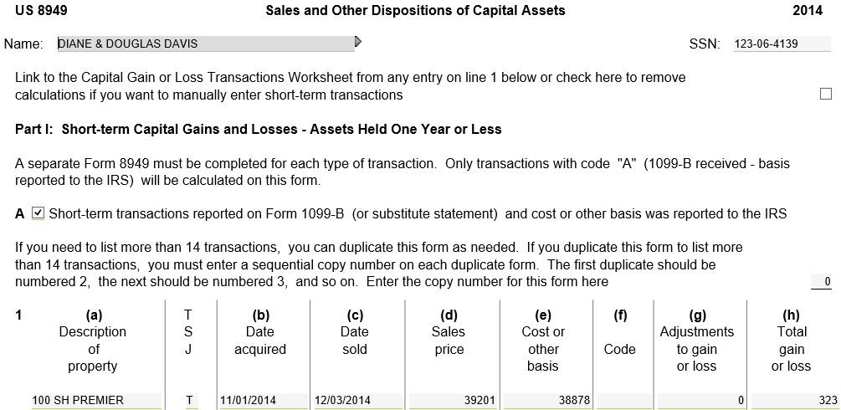
TW Sales & Other Dispositions of Capital Assets – Form 8949 for 1099 Code A
All 1099 code A transactions from Capital Gain/Loss Worksheet
Notes:
39

Slide 40
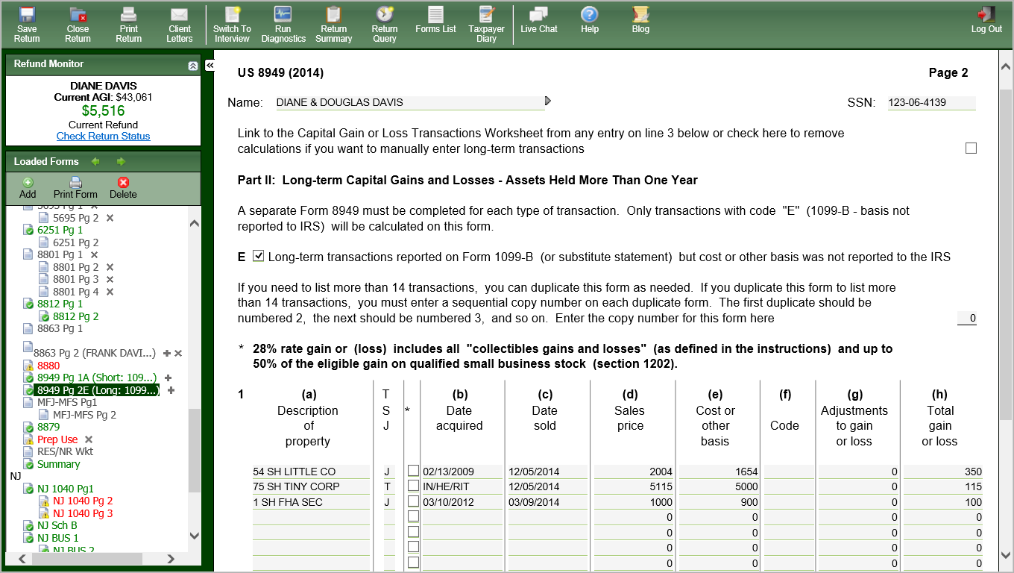
TW Sales & Other Dispositions of Capital Assets – Form 8949 for 1099 Code E
All 1099 Code transactions from Capital Gain/Loss Worksheet
Notes:
40

Slide 41
Capital Gains & Losses on Schedule D
TW transfers data from 8949s to Schedule D
Schedule D shows new summary lines of transferred totals
  Line 1b – S/T with Box A checked in Part I on 8949
  Line 2 – S/T with Box B checked in Part I on 8949
  Line 3 – S/T with Box C checked in Part I on 8949
  Line 8b – L/T with Box D checked in Part II on 8949
  Line 9 – L/T with Box E checked in Part II on 8949
  Line 10 – L/T with Box F checked in Part II on 8949
Notes:
41

Slide 42
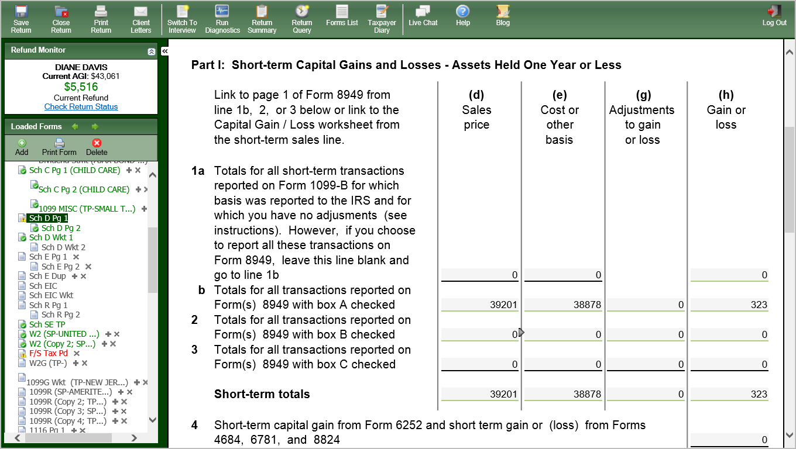
TW Schedule D Part I – Short-Term Capital Gains/Losses
Notes:
TW transfers short-term capital gains/losses info from Form 8949s to Schedule D Lines 1 – 3
Line 1b - S/T totals with Box A checked in Part I on 8949
Line 2 - S/T totals with Box B checked in Part I on 8949
Line 3 - S/T totals with Box C checked in Part I on 8949
42

Slide 43
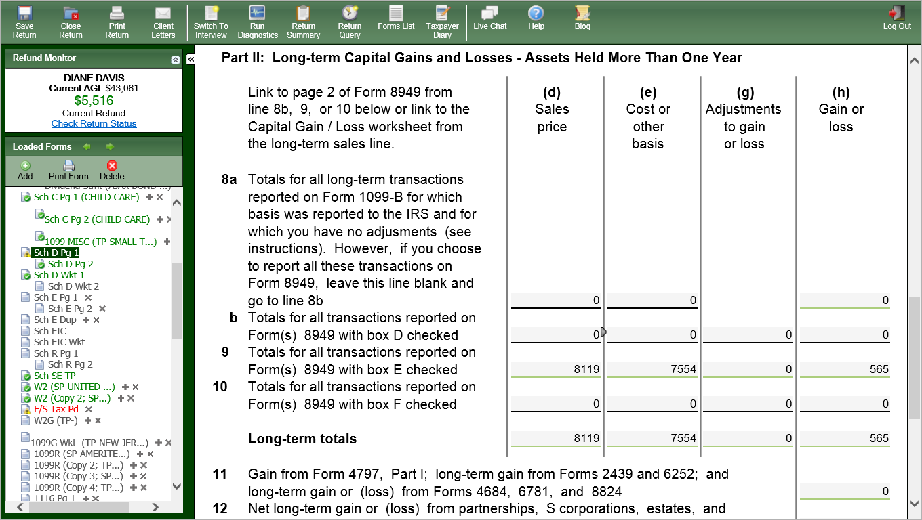
TW Schedule D Part II –
Long-Term Capital Gains/Losses
Notes:
TW transfers long-term capital gains/losses info from Form 8949s to Schedule D Lines 8 – 10
Line 8b – L/T totals with Box D checked in Part II on 8949
Line 9 - L/T totals with Box E checked in Part II on 8949
Line 10 - L/T totals with Box F checked in Part II on 8949
43

Slide 44
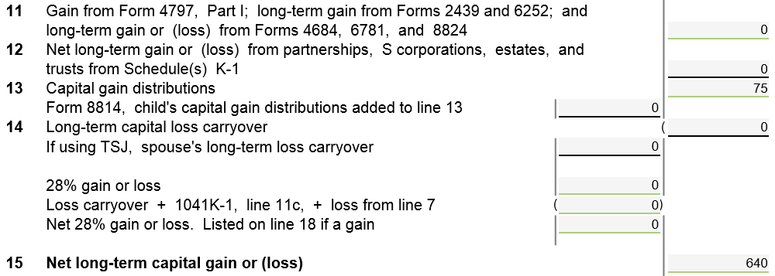
TW Schedule D Page 1 – Other Information
Capital gains distribution from
Dividend Statement
L/T capital loss carryover
Notes:
TW brings forward S/T capital loss carryover from last year’s return to Schedule D Line 6
If no carry-forward data from last year, obtain info from last year’s Schedule D Worksheet 2 Line 8
TW brings forward L/T capital loss carryover from last year’s return to Schedule D Line 14
If no carry-forward data from last year, obtain info from last year’s Schedule D Worksheet 2 Line 13
TW transfers capital gains distributions entered on Dividends Stmt from the 1099-DIV to Schedule D Line 13
44

Slide 45
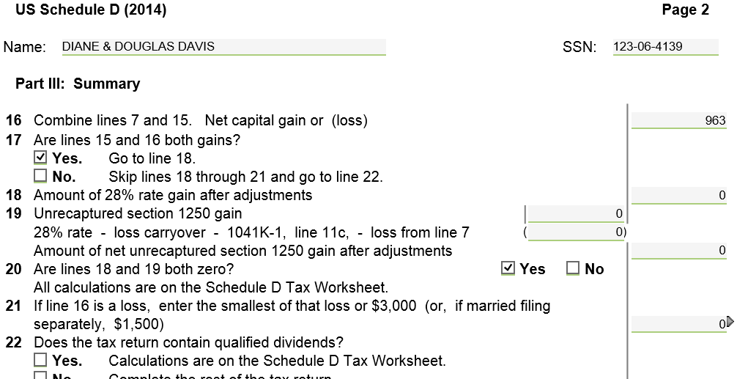
TW Capital Gains/Losses – Schedule D Page 2
Notes:
TW will populate summary on Sch D Part III on Page 2
TW will transfer Net Capital Gain/Loss to 1040 Line 13
45

Slide 46
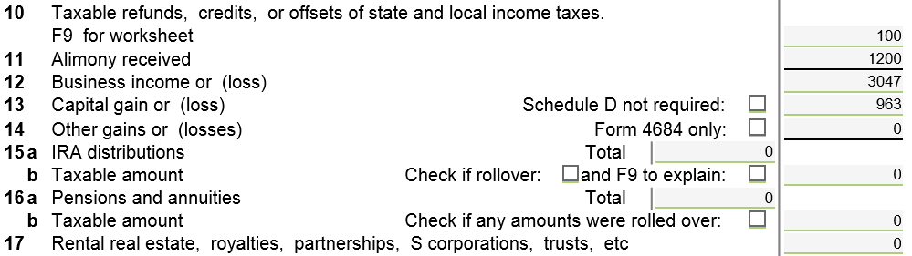
TW Capital Gain/Loss –
1040 Line 13
TW transfers from Schedule D
Notes:
TW transfers total from Schedule D Part III to 1040 Line 13
46

Slide 47
Schedule D Capital Gains/ Loss Worksheet – TW Tips
TW will transfer any capital gains distributions from Dividend Stmt to Sch D Line 13
Short-term/long-term capital loss carryover from last year is entered on Sch D Part I Line 6/Part II Line 14
TW calculates capital gain/loss & populates Sch D Part III
  Transfers net gain/loss to 1040 Line 13
NOTE: Loss on 1040 Line 13 is capped at $3,000. If loss is greater than that, Schedule D Worksheet 2 is created for Capital Loss Carryover to Next Year
Notes:
47

Slide 48
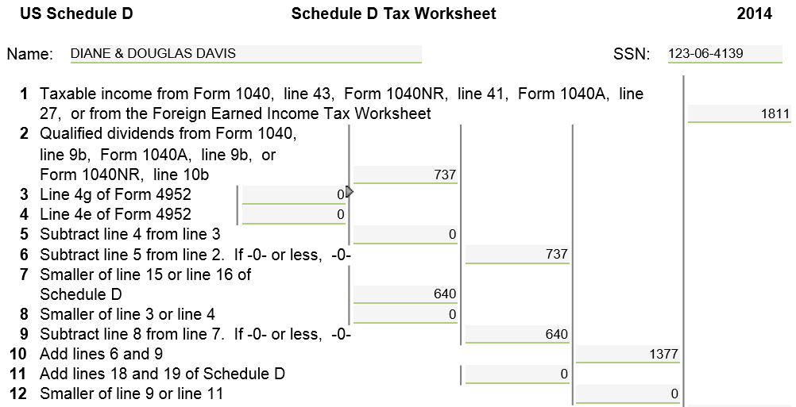
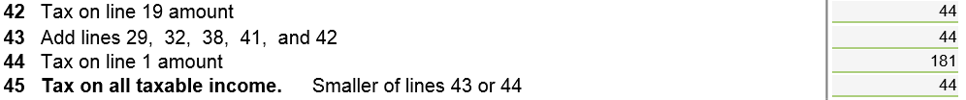
TW Schedule D Worksheet 1 – Tax on All Taxable Income
TW transfers from Schedule D
TW calculates tax on all taxable income
Notes:
TW calculates the tax on all taxable income on Schedule D Worksheet 1 (45 total steps in this calculation)
48

Slide 49
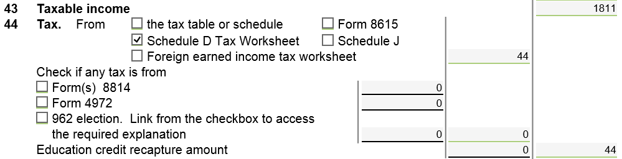
TW Tax – 1040 Line 44
TW transfers from Schedule D Wkt 1
& checks box for Schedule D Tax
Worksheet
Notes:
TW transfers total from Schedule D Wkt I Line 45 to 1040 Line 44
49

Slide 50
Consolidating Capital Gains Transactions on Capital Gains Worksheet
When entering capital gains transactions on Capital Gains Worksheet, can consolidate multiple transactions to single line based on the six 8949 categories
  Code A & D: Enter totals with Code M
    Preferred over using Sch D, lines 1a & 8a
  Code B & E: Enter individual transactions unless have ERO approval
    Will require extra paperwork and copies of brokerage statement
  Code C & F (rare): Always enter individual transactions
A detailed process for consolidating & required documentation is shown in TaxPrep4Free.org Special Topics. The documents are:
    “Consolidating Capital Gains” (for the preparer)
    “Form 8453 Instructions” (for the ERO)
Notes:
You are allowed to consolidate the transactions into subtotals based on the 1099 codes used on Form 8949 (i.e. – Codes A, B, D, E). Then you enter the subtotals on the Capital Gains Worksheet using Code M (plus other applicable codes)
When you consolidate transactions for Code A or D, no extra paperwork required.
When you consolidate transactions for Code B or E, you must send a copy of the brokerage statement plus all 8949s to the IRS along with Form 8453. See your ERO for help in mailing documents

Slide 51
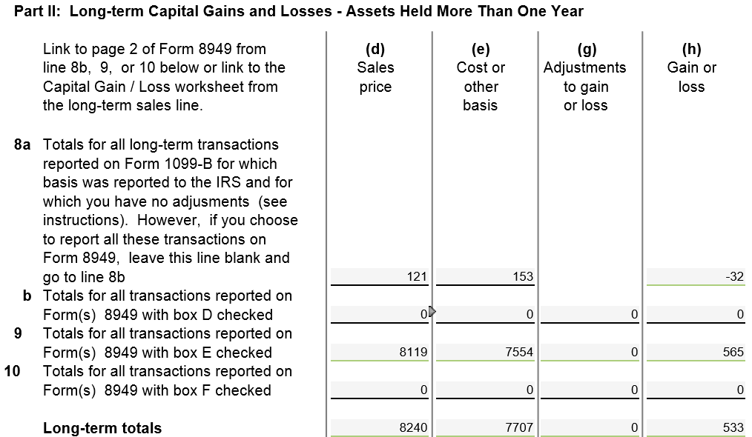
TW Sch D Part II
Entered on Capital Gains
Worksheet
Notes:
Pull up Schedule D Capital Gains and Losses screen
Link from Line 13 on 1040 Page 1 (using arrow or F9) OR
Go directly to Schedule D by clicking on Sch D Pg 1
Enter Totals of Sale Price and Cost basis on line 1a for short-term or 8a for long-term transactions that have basis reported to the IRS, have no wash sales, and have no adjustments
Transactions that do not meet the above criteria must be entered on the Capital Gains Worksheet as usual

Slide 52

Non-Taxable NJ Securities
Gains on certain NJ Securities are exempt from NJ tax even though subject to Federal capital gains tax
  See NJ Bulletin GIT-5 for a list of these securities (link from TaxPrep4Free.org Preparer page)
The NJ return has to be adjusted when this situation occurs
  Use a scratch pad to adjust NJ Sch B on Line 3

Slide 53
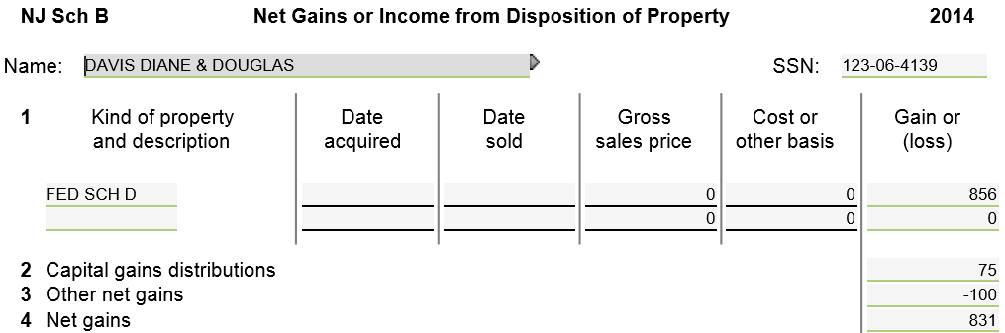
NJ Sch B
Link to a scratch pad to enter amount of gains on securities that are tax exempt in NJ
Notes:
Open NJ Sch B from the NJ Tree
Link to a scratch pad from Line 3 and include a negative number for the amount of the capital gains not taxable in NJ

Slide 54

Sale of a Home
What is Considered a “Main” Home?
Determined by facts – not by choice
Where taxpayer lives most of the time
If taxpayer is living in a rental, the rental might be considered the main home
Other places may qualify (house, boat, mobile home, apt, condo, etc.)
Land sale does not qualify
Notes:
Reverse Mortgages are non-tax event
Counselor does nothing
Related fees could impact cost basis when home is sold
If selling a non-main residence home, the loss can be considered a capital asset sale with a loss, entered on capital gain/loss transaction worksheet
54

Slide 55
Home Sale Terms
Selling Price - includes all monies received plus any mortgages or other debts taken over by the buyer (does not include amounts received for personal property sold with home--e.g. furniture or appliances)
Amount Realized - the selling price minus selling expenses
Selling Expenses - commission, advertising, legal fees, loan charges paid by seller
Basis – actual cost if bought or built
  Cost basis for property inherited in 2010 is lower of Fair Market Value at death or decedent’s cost basis Out of Scope
Adjusted Basis - the original cost plus /minus any increase or decrease to original basis (additions, eligible improvements)
Tax statement – Form 1099-S - Proceeds from Real Estate Transaction may be issued
Notes:
Can only adjust basis for additions & improvements that have a useful life of more than one year
55

Slide 56

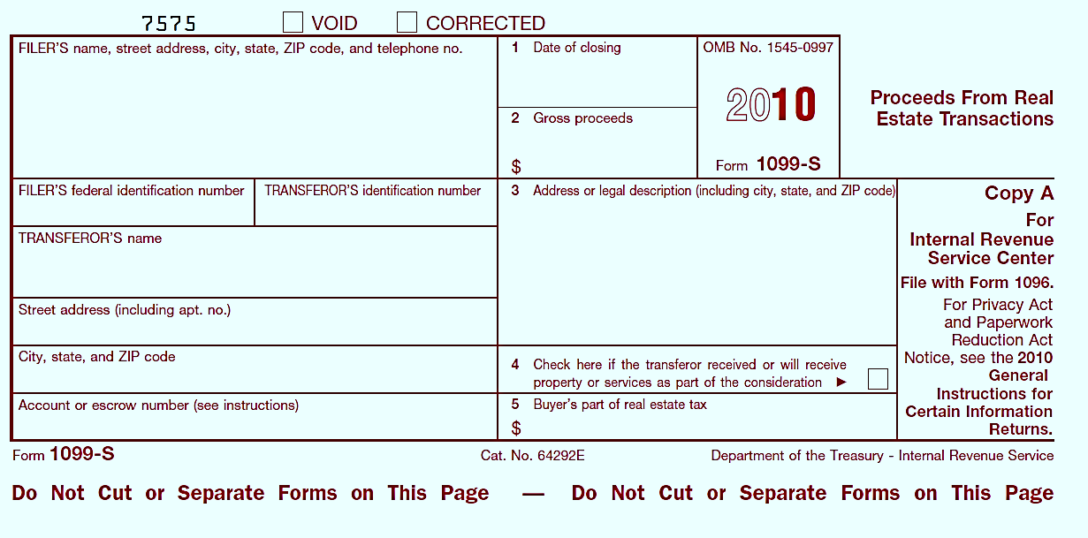
1099-S Proceeds From Real Estate Transaction
Includes cash or notes received for property
2014
Checked if other services or property is received as payment *
Note: 1099-S may not be provided if total gain can be excluded or if gains/loss from sale of other services or property are considered
Notes:
56

Slide 57

Calculating Home Sale
Gain/Loss
Amount Realized
minus Adjusted Basis
==============
Gain or Loss
Loss on sale of main home cannot be deducted & is not reported on tax return (unless 1099-S is issued – covered later)
Notes:
Remember:
Amount realized = selling price minus selling expenses
Adjusted basis = original cost plus/minus any changes to basis
57

Slide 58

House Sale Gain Exclusion
Ownership & Use Tests
Taxpayer who sold a qualified main home this year may qualify to exclude part or all of the gain from income
Must meet ownership & use tests (during the 5-year period ending on the date of sale)
  Ownership test - must have owned the home for at least 2 years AND
  Use test - must have lived in the home as your main home for at least 2 years
  Do not have to be the same 2 years for ownership & use tests
Notes:
58

Slide 59
Calculate House Sale
Gain Exclusion
Single homeowner can exclude up to $250,000 of gain from sale of main home
  Unmarried surviving spouse can exclude $500,000 if sale occurs within 2 years of spouse’s death
Married couple can exclude up to $500,000 of gain, if:
  Filed a joint return
  Both individuals meet the use test
    If only one meets use test, refer to Pub 17 – Sale of Home
  Either or both meet the ownership test
  Neither individual excluded gain in the 2 years before the current sale
Notes:
Exclusion can be used more than once in your life as long as it wasn’t taken in last 2 years
Pub 523 states if home was owned jointly and one spouse dies, decedent’s basis portion of home is adjusted to Fair Market Value at time of death. Surviving spouse’s basis remains the same. Total basis is the sum of these two numbers
59

Slide 60
Gain/Loss on Sale of House
No taxable gain - Do not report
Loss on personal property is not deductible
Report taxable gain on Schedule D
  Enter data on Capital Gain/Loss Transactions Worksheet
  1099 column - Category C (no 1099-B received)
  Code column – Code H (exclusion of gain on main home)
  Adjustments to Gain or Loss column – amount of gain that can be excluded as a negative number
Notes:
60

Slide 61
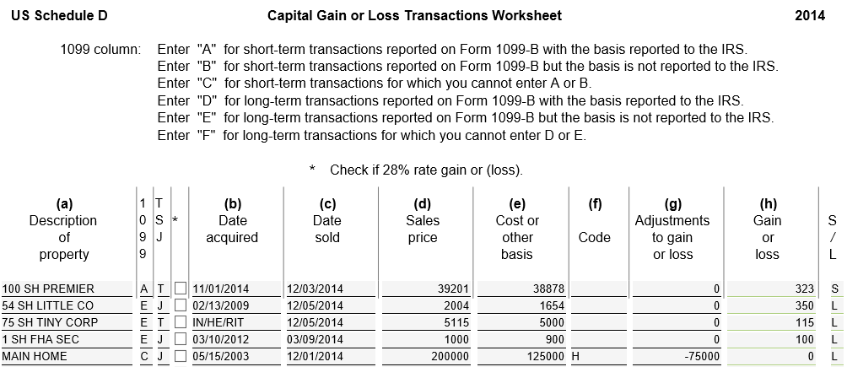
TW Capital Gain on Sale of Home –
Capital Gain/Loss Transaction Worksheet
B
Notes:
To report a capital gain on sale of home:
1099 column – Enter C (no 1099-B issued)
Code column – Enter Code H
Adjustments to Gain or Loss column – Enter amount of gain that can be excluded (up to $250,000 single, $500,000 joint)
Enter as a negative amount to reduce gain
When entering sales price and cost basis on sale of main home, make sure:
Selling price is adjusted by selling expenses/commission
Cost basis is adjusted by home improvements
Note: Sale of a second house is a regular sale and home gain exclusion does not apply
61

Slide 62
When 1099-S is Issued
1099-S usually not issued if total gain can be excluded or if sale results in a loss
If 1099-S is issued anyway, and entire gain is excludable :
  Show sale on Capital Gains/Loss Transaction Worksheet to notify IRS that gain was excludable
  Use “H” in Code column
Anytime a 1099-S is issued, must report it
Notes:
62

Slide 63
When 1099-S is Issued
Pub 4012 Tab D
(cont’d)
  If sale results in a loss, which is nondeductible, report the sale on Capital Gains/Loss Transaction Worksheet
    Enter Code “H” in Code column to show nondeductible loss
    Enter amount of loss in Adjustments to Gain or Loss column as positive number
    TW will zero out loss in Gain or Loss column
Notes:
63

Slide 64
Sale of Home on Preparer Page
See TaxPrep4Free.org Preparer page Special Topics document “Sale of Main Home” for detailed information on TaxWise entry of a home sale

Slide 65
Cancellation of Debt on Mortgage &
Foreclosure
Out-of Scope for most counselors, except:
Certain experienced counselors with special training
Notes:
65

Slide 66

Sale Of Business/Rental Property
Out Of Scope
Sam's Computer Center
Notes:
66

